Slide 1


Mobile Apps Design
Postgrado en
ADAPTERVIEWS AND ADAPTERS
Juan Luis Gorricho

Slide 2


SELECTIVE WIDGETS
Dynamic lists of views:
  Static view list: ListView,
  Unfolding list: Spinner,
  Expandable list: ExpandableListView,
  Grid: GridView.
All of them are subclasses of AdapterView,
AdapterView is a subclass of ViewGroup

Slide 3
ADAPTERVIEW
The views (from a list) to be displayed by an AdapterView are obtained from an Adapter, the interface to a given data structure, in contrast to handling static lists of views.
The purpose of AdapterView is two-fold:
  To fill out the corresponding layout,
  To handle a user selection from the list.
The purpose of Adapter is two-fold:
  Provide the access to the data structure,
  Provide the individual view of any element of the list.

Slide 4

ADAPTER
Implementations of Adapter (interface):
  BaseAdapter (abstract class)
  ArrayAdapter<T> (array of arbitrary objects)
  SimpleAdapter (to map static data to views defined in an XML file)
  SimpleCursorAdapter (adapter that exposes data from a Cursor)
  SimpleExpandableListAdapter (map static data to group and child views defined in an XML file)

Slide 5
BASEADAPTER
To create customized adapters we will extend our Adapter from BaseAdapter and overwrite the methods:
  public int getCount();
  public View getView(int position, View convertView, ViewGroup parent);
  public Object getItem(int arg0);
  public long getItemId(int arg0);

Slide 6
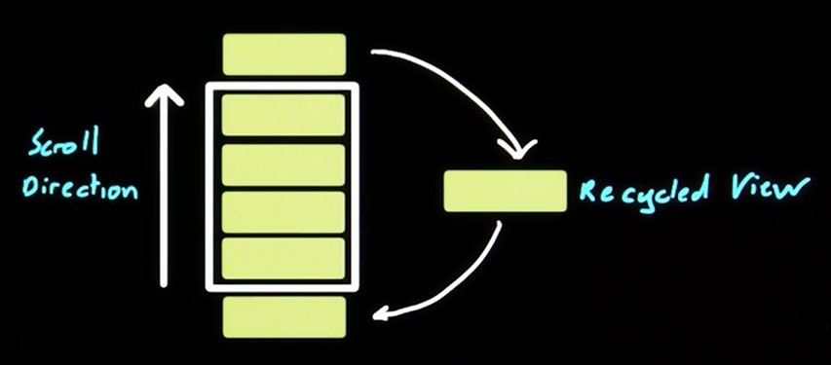

BASEADAPTER
The convertViews are constantly recycled in order to use only as many views as visible on the screen.

Slide 7

EXERCISE
Complete the code of MyAdapter_users
Complete the code of d_UsersListActivity to check the proper programming of MyAdapter_users as well.

Slide 8



EXERCISE
Complete the code of
MyAdapter_messages accordingly.
Complete the code of e_MessagesActivity to check the proper programming of MyAdapter_messages as well.

